Slide 1

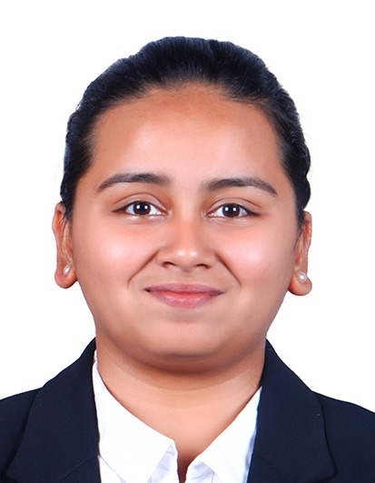



HOW WOULD YOU MAKE DISHWASHERS A HOUSEHOLD NECESSITY IN INDIA?
TEAM QUATTUOR NEXUS
AMEE ABHILASH DESAI
HARSHRAJ DESHMUKH
SRI SAIPRIYA R
UTKARSH KUMAR JHA

Slide 2






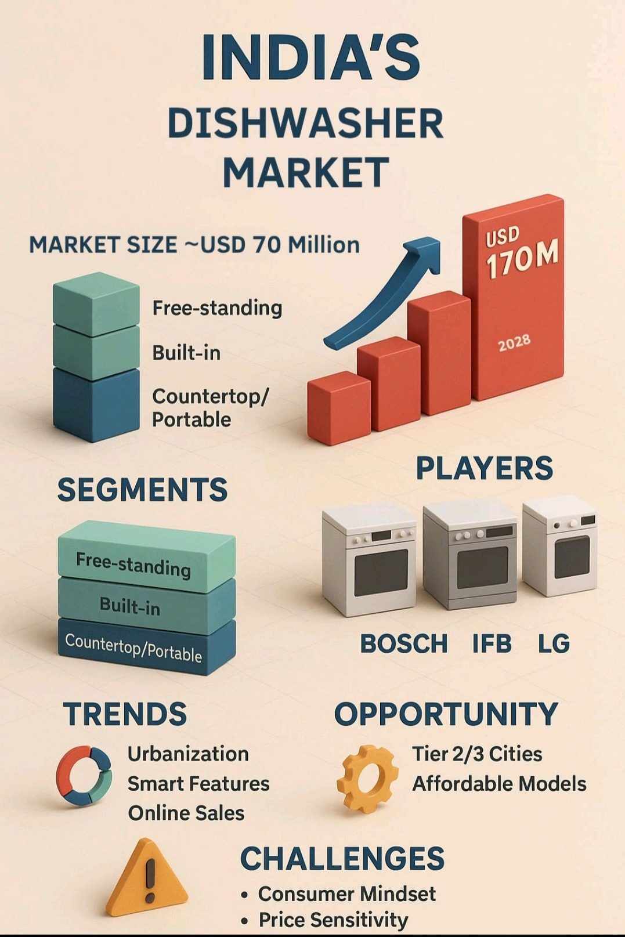

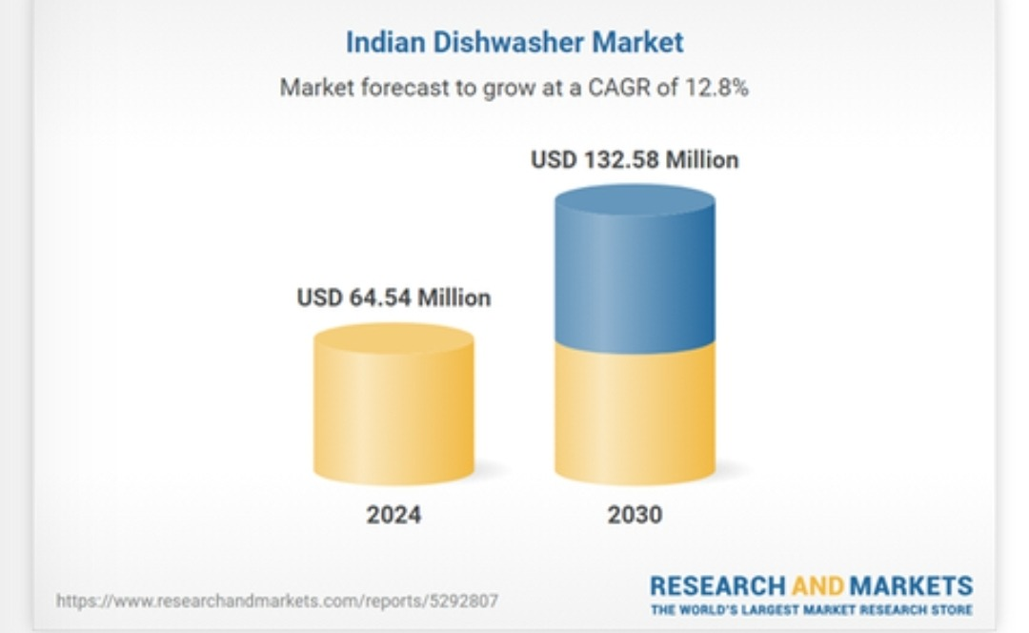

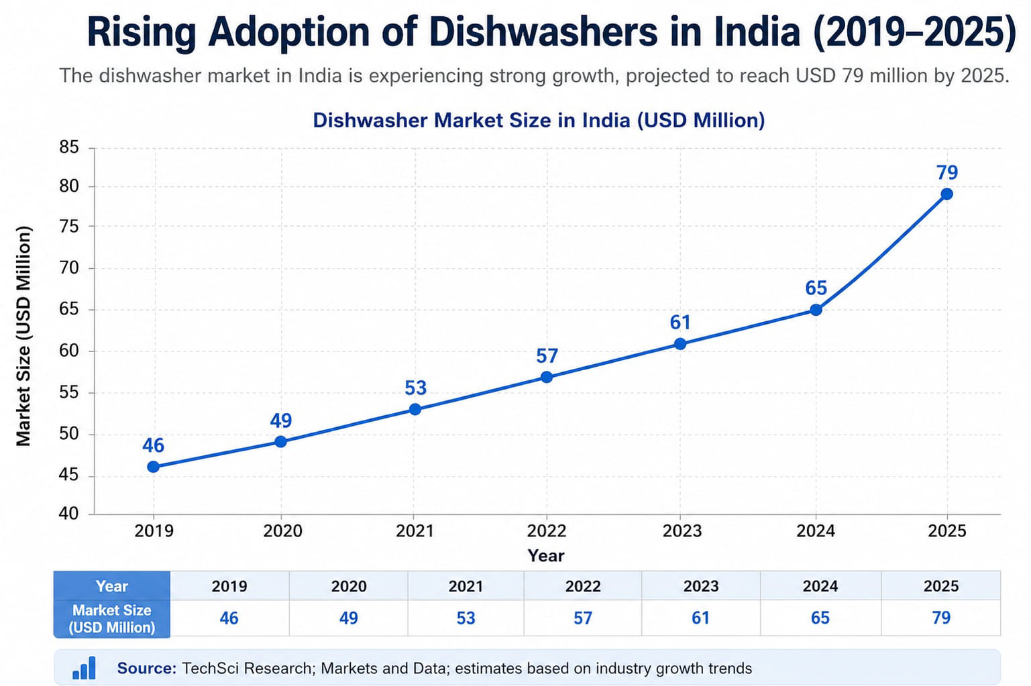
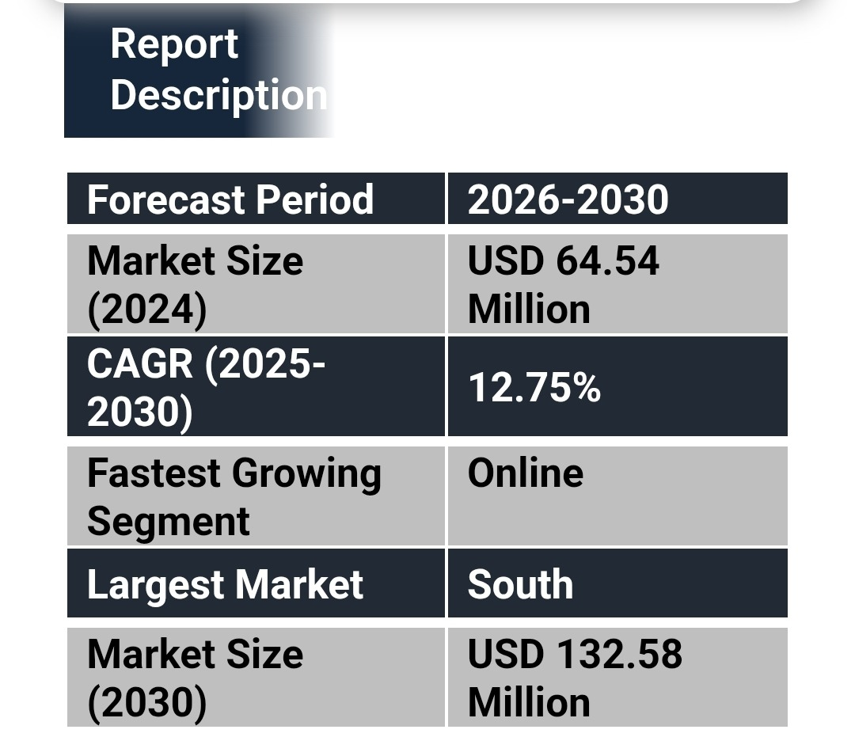

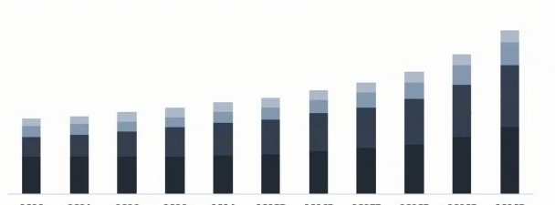
HOW WOULD YOU MAKE DISHWASHERS A HOUSEHOLD NECESSITY IN INDIA?
A dishwasher is an automated appliance used to clean utensils using water, detergent, and high temperature (60–70°C) ensuring better hygiene.
Uses 10–15 liters vs 60–100 liters in manual washing.
<2% household penetration in India,
mainly urban high-income households.
Water Efficiency
Better Hygiene
Time Saving
Energy Efficiency
Environmental Benefits
Convenience and Reduced Effort
Consistent Cleaning Quality
Better Rinsing
Awareness & Perception Gap- Seen as luxury appliance
Habit & Maid Dependency
Product Fit for Indian Kitchens
Space & Infrastructure Constraints- Standard size: ~60×60×82–85 cm
DISHWASHER IN INDIA- INTRODUCTION & HISTORY
ADVANTAGES OF USING DISHWASHER
CHALLENGES IN ADOPTING TO DISHWASHER IN INDIA
INDIAN CONTEXT
High Upfront Price
Preference for Manual Dishwashing
Low perceived ROI
HISTORY IN INDIA
CHALLENGES IN USING DISHWASHER
Early 2000s: Luxury Positioning-Premium Brands (Bosch, IFB)
2005–2018: Slow Growth- Slow awareness.
Post-2020: Growth- Post Covid Hygiene
Source: TechsciResearch, LinkedIn, Research and Markets, EPAWaterSense, Statista, Bosch, Economic Times, Choice Australia, Bajaj FinServ, General Appliance Research

Slide 3
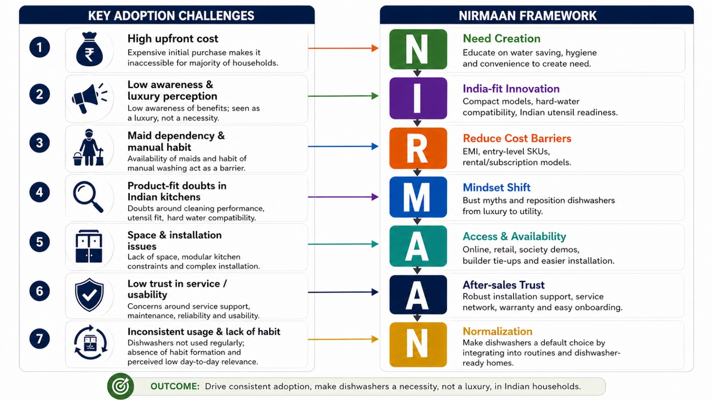






HOW WOULD YOU MAKE DISHWASHERS A HOUSEHOLD NECESSITY IN INDIA?
Urban nuclear families & dual-income couples - primary demand driver.
Premium apartment residents
modular kitchen penetration.
High water-scarcity urban households
10–15 L/cycle vs. 40–60 L/cycle.
Elderly & maid-dependent households
declining domestic help availability.
SOLUTION: NIRMAAN FRAMEWORK
"From Reluctance to Routine: Making Dishwashers an Indian Essential"
TARGET SEGMENTS
STAKEHOLDERS INVOLVED
Appliance brands & retailer ---
IFB, Bosch, LG.
Banks & fin-techs (EMI enablers) — pricing, discounts, and EMI options.
Builders & RWAs — pre-integration into modular kitchens, retrofitting in standard Indian kitchens.
Government & water bodies — Jal Jeevan Mission
1. Health Impact Reduction
2. Cognitive Load Reduction
3. Labor to Technology Shift
4. Environmental Sustainability
5. Economic Productivity Impact
EXPECTED OUTCOMES
IMPACTS
Inside home
Water conservation
Time and effort saving
Hygiene consistency
In market
Market Growth acceleration.
Strong Adoption Readiness.
Work-life convenience impact.
Appliance Ecosystem Expansion.
Sources: GlobeNewswire, Bonafide Research, ScienceDirect, Maximize Market Research, IMARC group, IJRISS, Euromonitor, KenResearch, Schencking &Stamminger, OECD, WHO.

